Slide 1


AM802002 Research and Enquiry
Week 2 (Session 2): How to conduct a literature review

Slide 2
In this lecture:
APA referencing
Writing the literature review

Slide 3
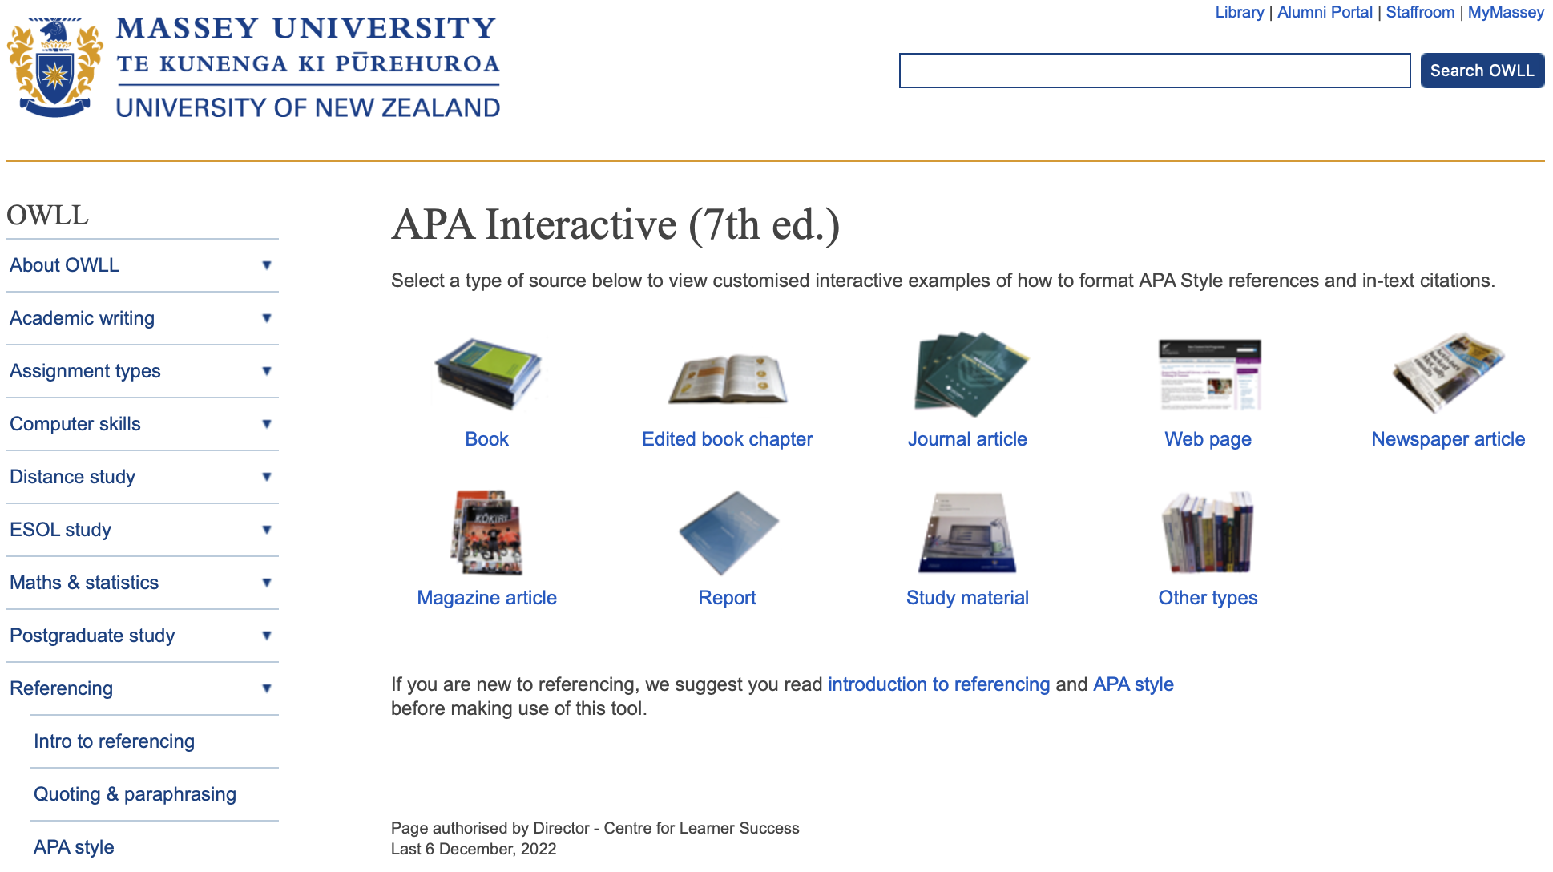
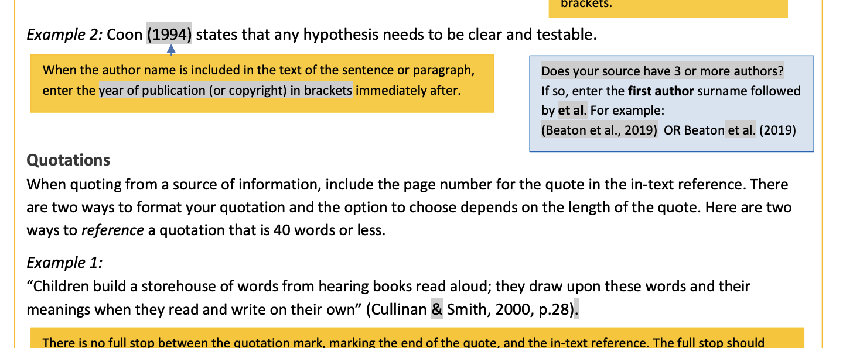
APA 7th edition
APA 7th guideline: https://studentsupport.op.ac.nz/assets/Uploads/OP-APA-7th-quick-guide-May-2020.pdf
Other sources: https://owll.massey.ac.nz/referencing/apa-interactive.php

Slide 4

Downloading Zotero
Zotero website: https://www.zotero.org/
How to use Zotero: https://www.youtube.com/watch?v=JG7Uq_JFDzE&t=42s

Slide 5
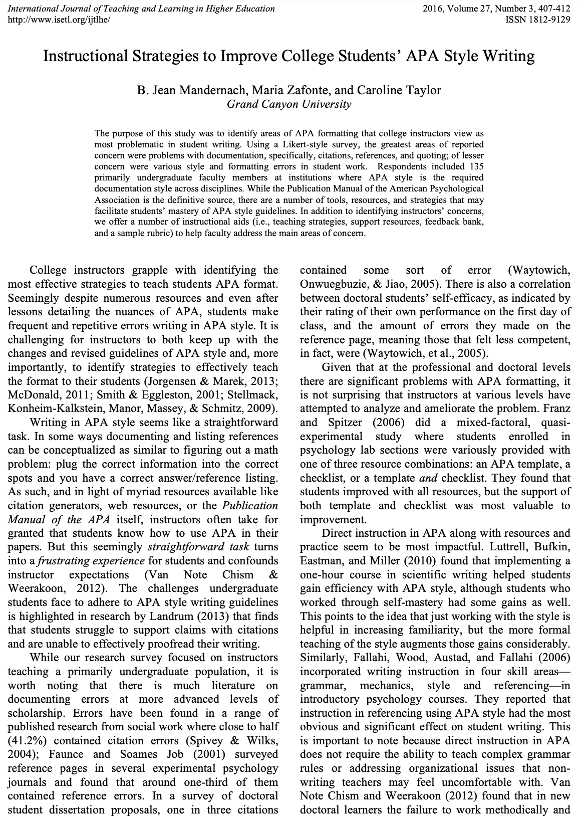
Doing APA referencing correctly
Mandernach, B. J., Zafonte, M., & Taylor, C. (2016). Instructional Strategies to Improve College Students' APA Style Writing. International Journal of Teaching and Learning in Higher Education, 27(3), 407-412.

Slide 6
Activity One (Class)
Group Discussion on APA referencing
Organise into working groups of 4-5 members
Sitting with your working group, listen to the Doing APA Referencing Correctly Podcast
Working as an individual, take notes during the podcast
Working as a team, discuss key takeaways from the podcast
Working as a team, create a summary of key takeaways
2. Present group summary to the class
Select a team member to present the summary to the class

Slide 7
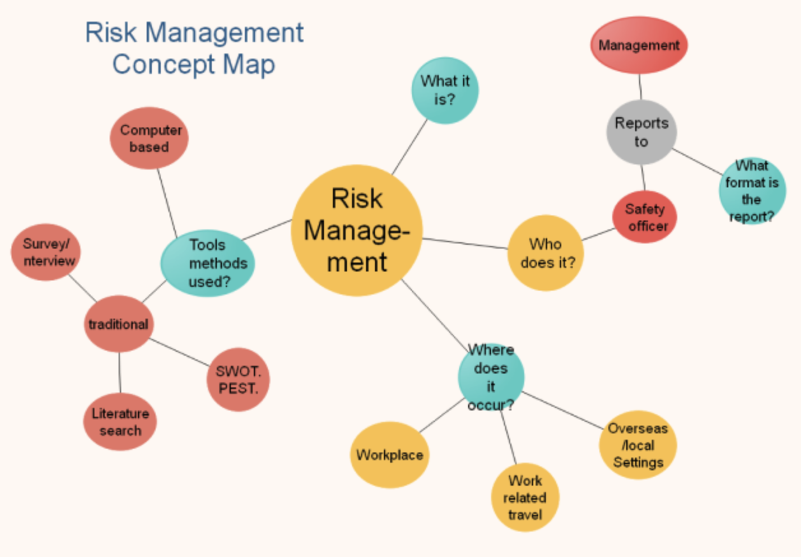
Concept Maps

Slide 8
Writing the Literature Review
There are five steps in the creation of a literature review:
Scanning documents (remember the reading strategy and video)
Making notes, (Literature Worksheet template)
Structuring the literature review,
Writing the literature review,
Building the bibliography (i.e., your reference list)

Slide 9
Five ‘C’s of writing a literature review
Cite | Keep the primary focus on the literature pertinent to your research problem
Compare | The various arguments, theories, methodologies and findings expressed in the literature: What do the authors agree on? Who applied similar approaches to analysing the research problem?
Contrast | The various arguments, themes, methodologies, approaches and controversies expressed in the literature: What are the major areas of disagreement, controversy or debate?
Critique the Literature | Which arguments are more persuasive and why? Which approaches, findings, methodologies seem most reliable, valid or appropriate and why? Pay attention to the verbs you use to describe what an author says/does
Connect | The literature to your own area of research and investigation: How does your own work draw upon, depart from, or synthesis what has been said in the literature? (You may think about this when doing your own research project, e.g., masters thesis) Note: Methodology is not the focus of Assessment One

Slide 10
Examples of critical language
Introducing the article:
The author set out to…
The author investigated…
The purpose of this study was to…
The author argues that…
The perspective presented here is that…
The point of view argued here is that…
The authors intention was to…

Slide 11
Examples of critical language
Commenting on strengths:
The study sheds light on…
The study highlights the importance of…
It is clear how…
The study reflects the significance of…

Slide 12
Examples of critical language
Raising questions, commenting on weaknesses:
It does not seem to follow that…
The author’s argument falls down in that…
The author’s argument seem to be that
The argument that … does not hold because…
The assumption that…
The author assumes that…
Questions must be raised in relation to…

Slide 13
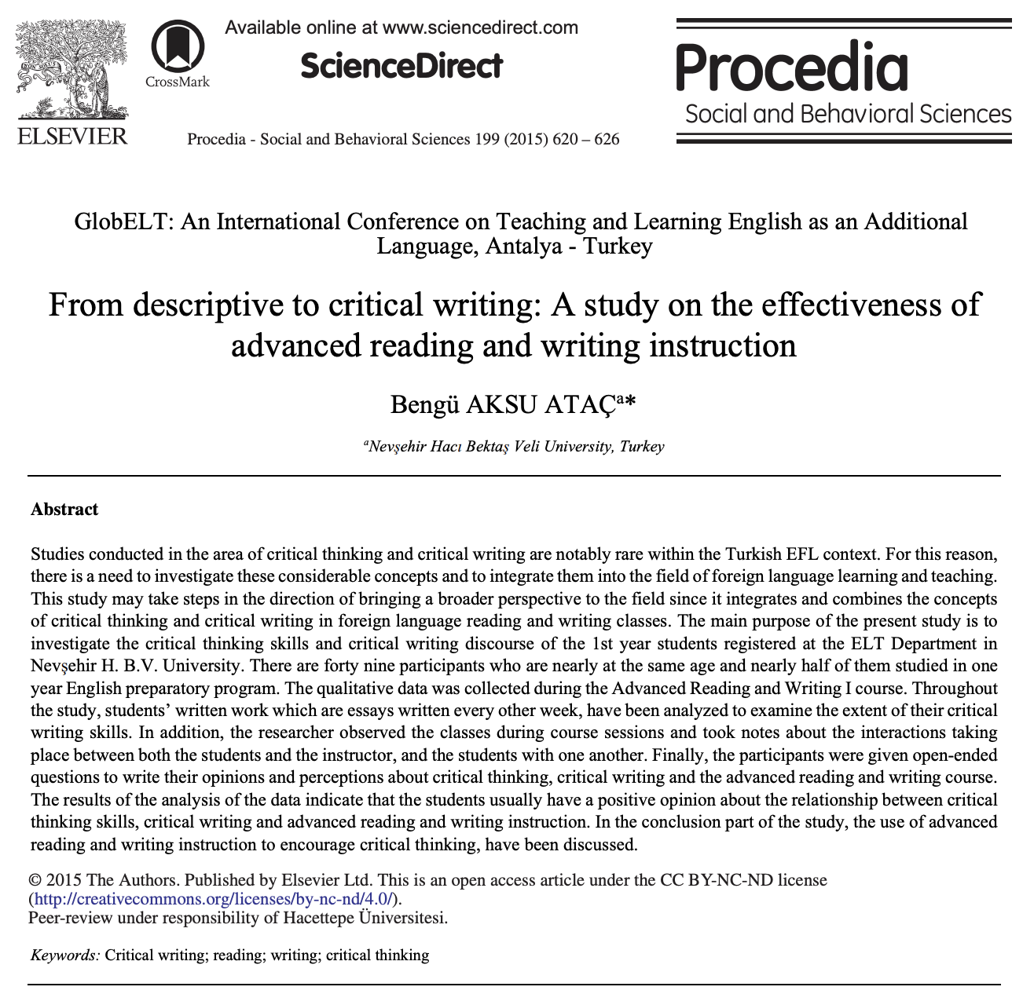
Critical writing
Ataç, B. A. (2015). From descriptive to critical writing: A study on the effectiveness of advanced reading and writing instruction. Procedia-Social and Behavioral Sciences, 199, 620-626.

Slide 14
Activity Two (Individual)
1. Reflecting on the differences between descriptive and critical writing
Listen to the Critical Writing Podcast
Working as an individual, take notes during the podcast
Reflect in writing on the key takeaways from the podcast
2. Writing a revised draft of your critical review for Assessment One due 9 am Monday 28 October
Use the Literature Worksheet you have completed and your research question to write a draft of your critical review
3. Seek feedback from the RMS chatbot on your draft critical review
Write a ten-sentence summary of the conversation.
Add this ten-sentence summary to the Assignment One Section of your Teams Notebook.

Slide 15
Questions around Assessment One

Slide 16
Self-study
1. Conduct a deep reading of Mandernach et al. (2016) and Ataç (2015) to become familiar with APA referencing and critical writing
2. Write a revised draft critical review for Assessment One due 9 am Monday 28 October:
To help you get started, have a look at the exemplars of Assessment One on Moodle.
Use the Literature Worksheet you have completed and your research question to write a revised draft of your critical review
3. Get feedback from the RMS Chatbot on your revised draft critical review.
Have a conversation with the RMS Chatbot about your revised draft critical review.
Write a ten-sentence summary of the conversation. Compare this summary with the previous feedback summary you have written. Write five sentences comparing these two summaries.
Add this ten-sentence summary of the conversation and the five-sentence comparison to the Assignment One Section of your Teams Notebook.

